Slide 1
The Establishment of “APU Student Volunteers” Organization with Centralized Web Application to Facilitate Co-Curriculars Placement
SHARIPOVA TAKHMINA (TP049310)
UC3F2005(BIS)
Supervised by : MS PALVINDERJIT kaur harnek singh
2nd Marker : Ms. NUR KHAIRUNNISHA BINTI ZAINAL

Slide 2
Problem Statement
APU: Five (5) intakes with ten (10) programmes / year.
Co-curricular or extra-curricular studies are Mandatory.
Means: “WhatsApp” messenger groups & radio marketing.
APU Event Organizers struggle to find volunteers.
No student volunteer organization.

Slide 3
Aim
To establish a “Student Volunteers” organization to offer a centralized multi-functional web application with informational value on open volunteering experiences to facilitate communication between co-curriculars seekers and APU event marshals with focus on offline post-pandemics situation.

Slide 4
Objectives
To establish “Student Volunteers” organization subsequently COVID-19 pandemics.
To design a replacement of “WhatsApp” messenger for volunteering experience search.
Enhance search for volunteers for Event Organizers.
To provide informational value on types of volunteering opportunities for all.

Slide 5
Functionalities
Target Users:
Volunteers: apply for Volunteer Opportunities.
Event Marshals: create & issue Volunteer Opportunities.
Administrator: create, edit or delete user accounts & edit volunteer opportunity info.
All: Register, login & edit personal profile data.

Slide 6
Company Background
Asia Pacific University of Technology and Innovation (APU): top private universities in Malaysia with excellent performance according to SETARA Rating.
Location: TPM, KL, Malaysia
Vision: to educate students into highly employable, knowledgeable and future-proof professionals.
Mission: to develop enriching and distinctive learning experiences to provide high-quality, accessible, innovative and internationally benchmarked education in a professional, ethical and student-centric manner.

Slide 7
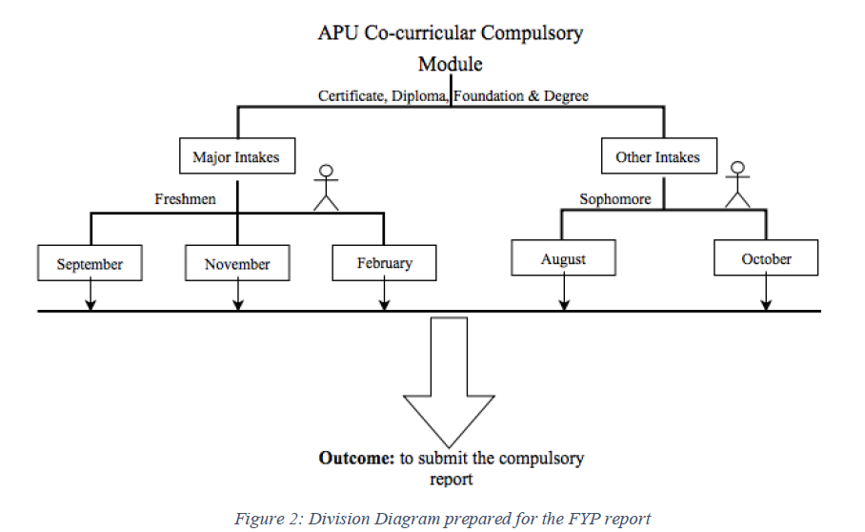

Slide 8
Technical Research
Programming Language: ASP.NET – C#, HTML5, CSS3, JavaScript
Database Management System: Microsoft SQL Server 2019
IDE: Microsoft Visual Studio 2019
Libraries: Visual Studio built in
Web Browser: Chrome, IE, Firefox, Safari

Slide 9

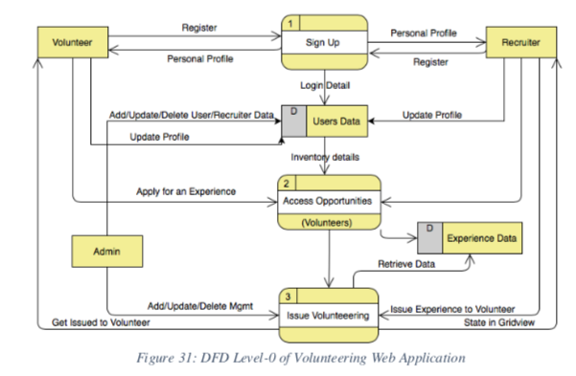
Design: DFD – Level 0

Slide 10
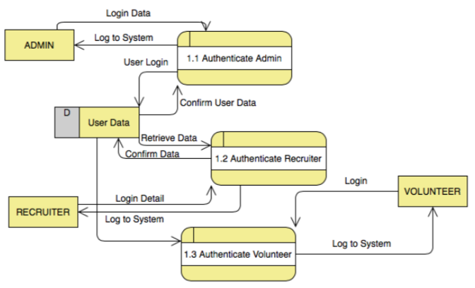
Design: DFD – Level 1

Slide 11
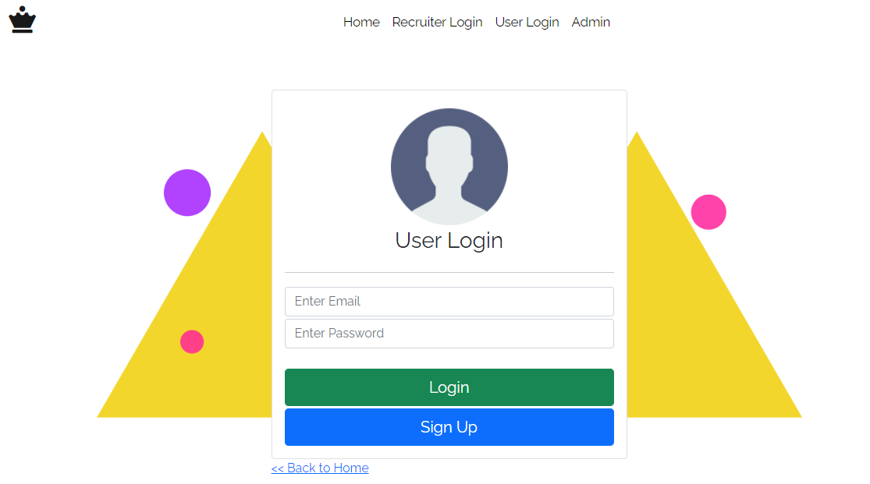
Interface design
Emphasis on user friendly design.
Target users won’t all be experts.
System must be easy to use.

Slide 12
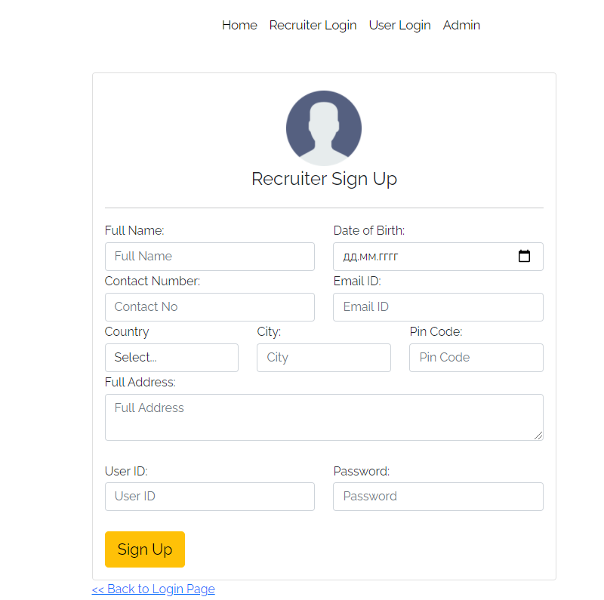
Implementation
Integration of RFID scanner with system.
Sending e-mail orders to suppliers.
Creating dynamic tables on web pages.
Implementing Forms authentication.

Slide 13
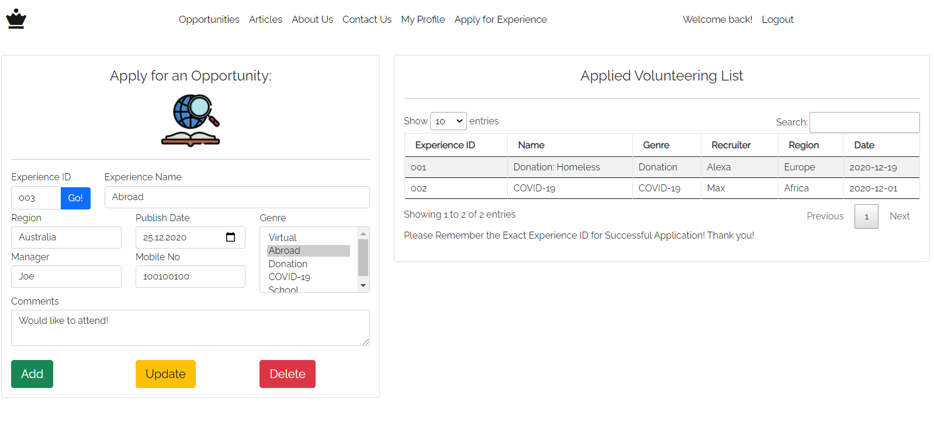
Implementation

Slide 14
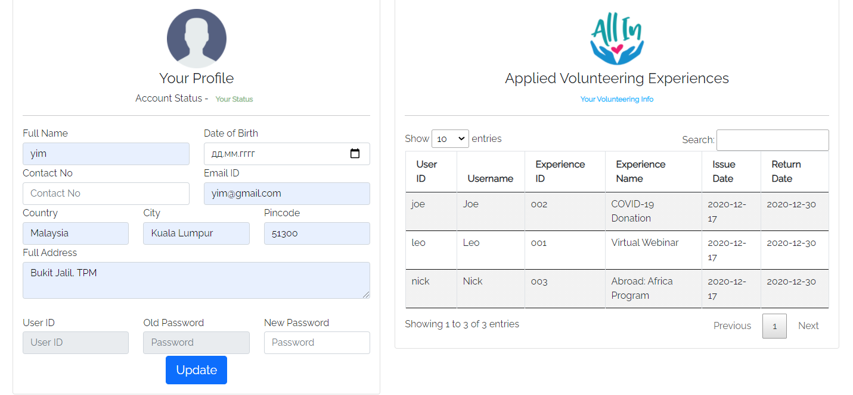
Implementation

Slide 15
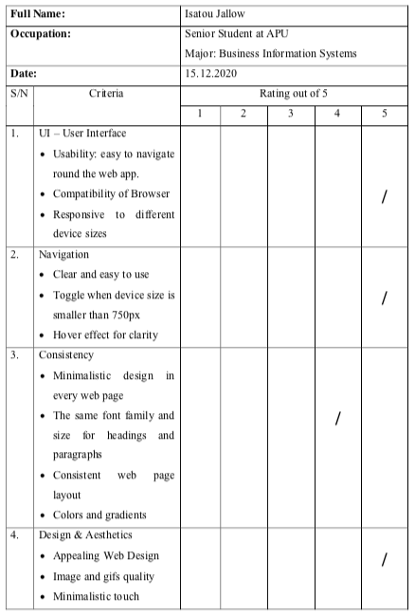
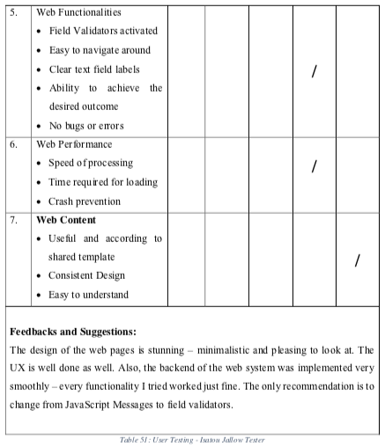
UAT Results: (1)

Slide 16
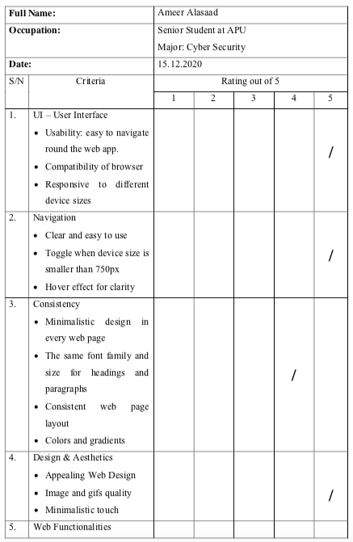
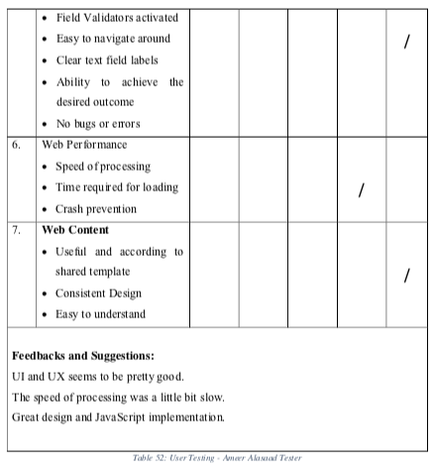
UAT Results: (2)

Slide 17
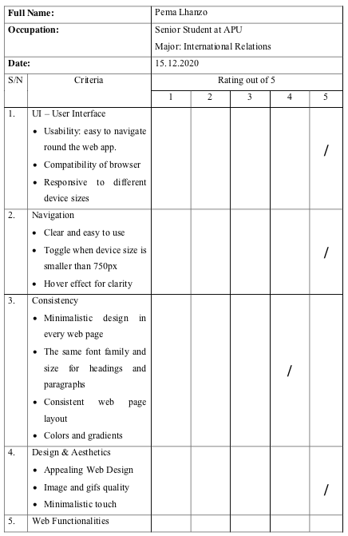
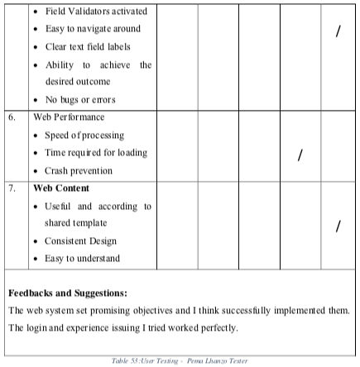
UAT Results: (3)

Slide 18
Problems and Limitations
Duplication of Master Page: total 2.
No simultaneous User Profile data update.
Need for more Volunteer Experience Details

Slide 19
Future Enhancement and Planning
Resolution of the Current Limitations:
centralized master page
personal profile textboxes connection to the SQL Database
add more experience
Secure HTTP (HTTPS) for enhanced security.
Full optimization for mobile devices.

Slide 20
Thank you!

